Slide 1
Learn Java’s
Loop Statements

Slide 2

Java Flow Control Statements
Conditional Statements
Loop Statements

Slide 3
Java Loop Statements
For Loop
While Loop
Do-While Loop

Slide 4
Java Loop Statements
For Loop
While Loop
Do-While Loop
Notes:
Pages 88 – 91 (Part 1) Java 4 Selenium WebDriver
Add a note from Camtasia that can be changed stating:
“Questions can be Answered in the upcoming VIP Live Session”
“Questions can be Answered in the VIP Live Session”

Slide 5
Java Loop Statements
For Loop
While Loop
Do-While Loop
Notes:
Pages 92 – 93 (Part 1) Java 4 Selenium WebDriver
Add a note from Camtasia that can be changed stating:
“Questions can be Answered in the upcoming VIP Live Session”
“Questions can be Answered in the VIP Live Session”

Slide 6
Java Loop Statements
For Loop
While Loop
Do-While Loop
Notes:
Pages 94 – 97 (Part 1) Java 4 Selenium WebDriver
Add a note from Camtasia that can be changed stating:
“Questions can be Answered in the upcoming VIP Live Session”
“Questions can be Answered in the VIP Live Session”

Slide 7
For Loop
Syntax
for (initialization; condition; iteration)
{
statement(s);
}
Argument | Description
for | Keyword that starts the for loop
initialization | Assignment that sets the loop control initial value
; | Semi-colon completes the initialization
condition | A boolean expression that determines if the loop will or will not repeat
; | Semi-colon completes the condition
iteration | Indicates how the loop control variable will change after each variation
{ | An opening curly bracket
statement(s) | Statement(s) that will execute after the condition is met
; | Semi-colon completes the statement
} | A closing curly bracket

Slide 8
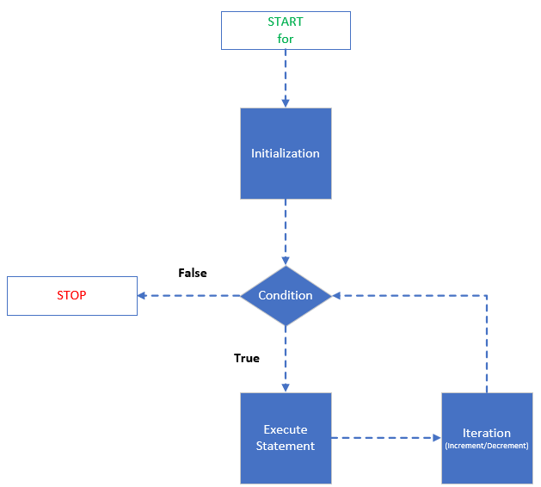
For Loop Flow Chart

Slide 9
While Loop
Syntax
while (condition)
{
statement(s);
}
Argument | Description
while | Keyword that starts the loop
condition | A boolean expression that determines if the loop will or will not repeat
{ | An opening curly bracket
statement(s) | Statement(s) that will execute after the condition is met
; | Semi-colon that completes the statement
} | A closing curly bracket

Slide 10
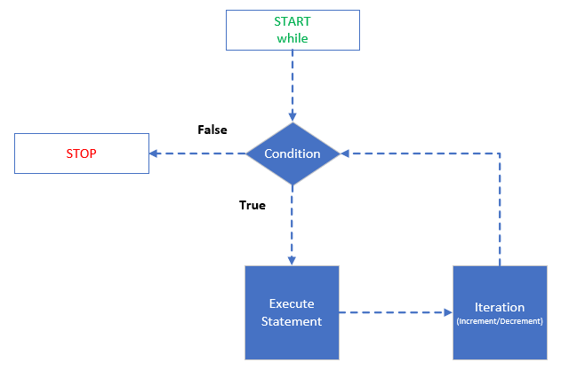
While Loop Flow Chart

Slide 11
D0-While Loop
Syntax
do
{
statement(s);
}
while (condition);
Argument | Description
do | Keyword that starts the loop
{ | An opening curly bracket
statement(s) | Statement(s) that will execute at least once
; | Semi-colon that completes the statement
} | A closing curly bracket
while | Keyword that determines if the loop’s condition will repeat
condition | A boolean expression that determines if the loop will or will not repeat
; | Semi-colon that completes the condition

Slide 12
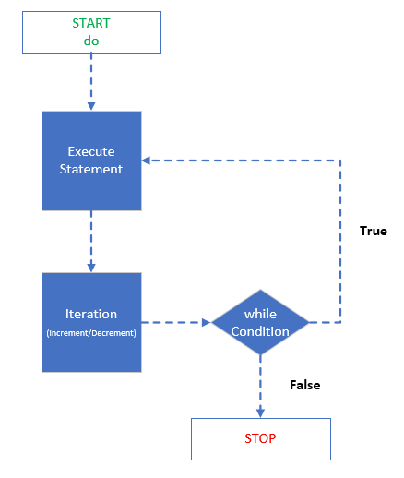
Do-While Loop Flow Chart

Slide 13
Which Loop Do I Use?
Use the For Loop When The Number Of Iterations/Loops Are Known
Use The While Loop When The Number of Iterations/Loops Are Unknown
Use The Do-While Loop When The Loop Must Run At Least One Time

